Slide 1
STEM CELLS IN NEUROSURGEY

Slide 2
The Fundamental axiom of neuroscience
“the adult human brain, in contrast to other
organs such as skin and liver, lacked the
capacity for self repair and regeneration.”
no longer considered true.

Slide 3
Cell replacement therapy is an exciting research area
Offers potential treatment for
developmental
traumatic &
degenerative neurological
diseases for which there is currently no cure.

Slide 4
Stem cells
Defined by two main properties: self-renewal and multipotency
Stem cells
Embryonic
Blastocyst inner cell
mass
Fetal
fetal blood
and tissues
Adult

Slide 5
Embryonic Stem cells
Cells derived from the inner cell mass
Can be propagated indefinitely in culture
Characteristic set of markers
Lack of contact inhibition
Atypical cell cycle regulation
Form teratocarcinomas in nude mice
Ability to differentiate

Slide 6
Fetal Stem Cells
The "building block" cells of blood, tissue and organs
Earliest cells found in the fetus, which then replicate efficiently and rapidly to create more blood, liver tissue, heart tissue
Umbilical cord blood is a rich source

Slide 7
Adult stem cells
Potential source of autologous cells for transplantation therapies that eliminates immunological complications.
First recognized in the hematopoietic system with the development of bone marrow transplantations.
Discovery of unexpected plasticity and regenerative capabilities in the adult CNS made it the first solid organ system shown to possess somatic stem cells.

Slide 8
Neural Stem Cells
First inferred from evidence of neuronal turnover in the olfactory bulb and hippocampus
Cells with more restricted neural differentiation capabilities committed to specific subpopulation lineages
Currently, there is still no set of markers or protein expression profiles that precisely define and fully characterize undifferentiated NSCs

Slide 9
Induced pluripotent stem cells
Type of pluripotent stem cell artificially derived from a non-pluripotent cell, typically an adult somatic cell, by inducing a "forced" expression of certain genes.
Are believed to be identical to natural pluripotent stem cells
first produced in 2006 from mouse cells and in 2007 from human cells.
Yu J, Vodyanik MA, et al. | Induced Pluripotent Stem Cell Lines Derived from Human Somatic Cells | Science DOI: 10.1126/science.1151526
Oncogenecity is a concern
Takahashi, K. & Yamanaka, S. Induction of pluripotent stem cells from mouse embryonic and adult fibroblast cultures by defined factors. Cell 2006;126:663–676

Slide 10
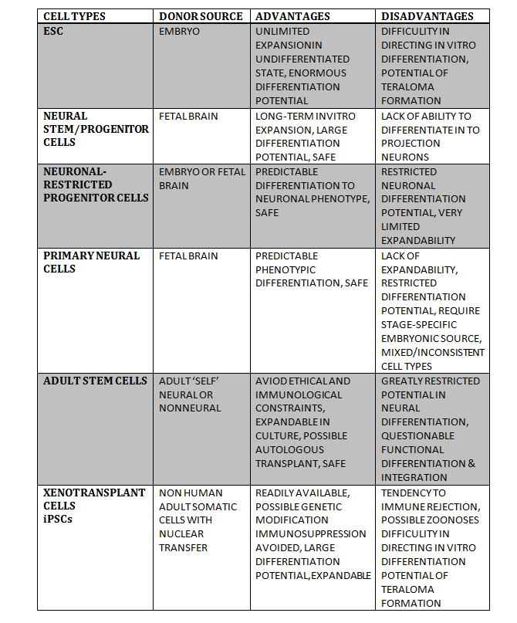

Slide 11
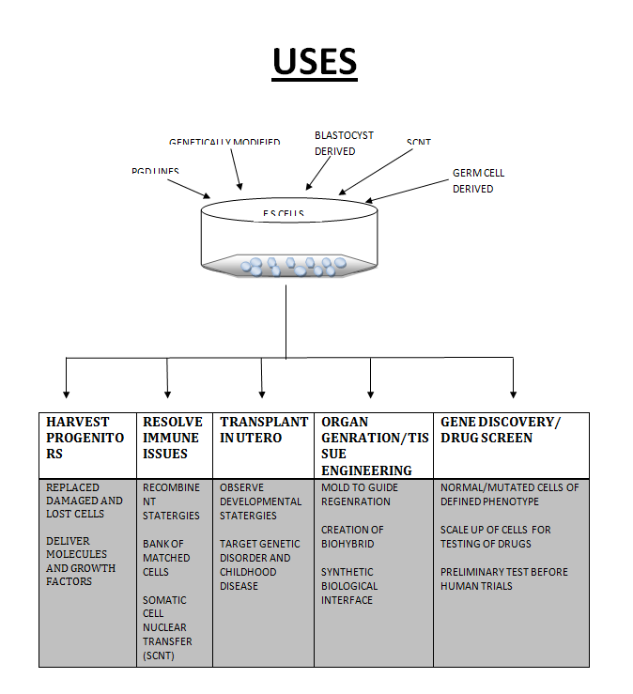

Slide 12
Treatment of Brain Cancer
Malignant gliomas represent a significant challenge
Urgent need for the development of more effective therapies
A therapeutic delivery system that could ‘‘seek out’’ dispersed tumor cells
One promising method of meeting this challenge is the use of neural stem cells (NSCs) and mesenchymal stem cells (MSCs).

Slide 13
Stem cells as delivery vehicles
Ability of stem cells to ‘‘home in’’ to areas of intracranial pathologic change
Aboody KS, Brown A, Rainov NG, et al. Neural stem cells display extensive tropism for pathology in adult brain: evidence from intracranial gliomas. Proc Natl Acad Sci USA 2000;97:12846–51
Drug delivery to disseminated tumor cells

Slide 14
Immunostimulatory cytokines
Retroviral mediated gene transfer to induce expression of mouse interleukin (IL)-4 (C57.npr.IL-4) or the lysosomal enzyme, galactocerebrosidase (C57.npr.GALC)
Benedetti S, Pirola B, Pollo B, et al. Gene therapy of experimental brain tumors
using neural progenitor cells. Nat Med 2000;6:447–50.
NSC tropism for glioma could be exploited for therapeutic benefit by engineering NSCs to express and deliver IL-12

Slide 15
Prodrug activation enzymes
Prodrugs are compounds on chemical modification by specific enzymes, converted to physiologically active molecules
NSCs could be engineered to express the bioactive transgene for CD, an enzyme that converts the nontoxic prodrug 5-FC to 5-FU
Aboody KS, Brown A, Rainov NG, et al. Neural stem cells display extensive tropism for pathology in adult brain: evidence from intracranial gliomas. Proc Natl Acad Sci USA 2000;97:12846–51
NSCs permitted the delivery of a prodrug-activating enzyme directly to tumor cell , enhancing the tumor-toxic effect & minimizing local toxicity

Slide 16
Viral vectors
Cellular vehicles for the delivery of replication-conditional oncolytic herpes simplex virus
Herrlinger U, Woiciechowski C, Sena-Esteves M,et al. Neural precursor cells for delivery of replication-conditional HSV-1 vectors to intracerebral gliomas.Mol Ther 2000;1:347–57.
An important tool for a targeted therapeutic attack against disseminated glioma

Slide 17
Proapoptotic proteins
Members of the tumor necrosis factor (TNF)family
TNF-related apoptosis-inducing ligand (TRAIL), has been shown to induce apoptosis selectively in malignant glial cells while sparing normal tissue
Inoculation of TRAIL secreting NSCs into gliomatous brain
Ehtesham M, Kabos P, Gutierrez MA, et al. Induction of glioblastoma apoptosis using neural stem cell-
mediated delivery of tumor necrosis factor-related apoptosis-inducing ligand. Cancer Res 2002;62:7170–4.

Slide 18
Inherent antitumor activity of neural stem cells
Benedetti and colleagues first presented evidence suggesting that exogenously administered unmodified NSCs may be independently capable of inhibiting glioma proliferation in vivo
Benedetti S, Pirola B, Pollo B, et al. Gene therapy of experimental brain tumors
using neural progenitor cells. Nat Med 2000;6:447–50
The exact mechanisms remain unclear.
NSCs may elaborate certain factors, such as transforming growth factor (TGF)-b
Staflin K, Honeth G, Kalliomaki S, et al. Neural progenitor cell lines inhibit rat tumor
growth invivo. Cancer Res 2004;64:5347–54

Slide 19
Future perspectives and challenges
Preliminary evidence has established the promise of stem cell therapy for malignant glioma.
Significant concerns must be addressed :
ethical, immunological etc.
An optimal stem cell candidate must not only be readily accessible but should possess significant migratory capabilities and display robust tumor tropism.
Additional sources must be explored

Slide 20
Traumatic Brain Injury
Many head-injured patients incure permanent neurologic impairment.
Neurogenesis increases in response to mechanical brain injury in multiple areas of the adult mammalian brain.
Studies have shown posttraumatic neurogenesis occur in hippocampus, subventricular zone and some extent in cortex
Kernie SG, Erwin TM, Parada LF. Brain remodeling due to neuronal and astrocytic proliferation
after controlled cortical injury in mice. J Neurosci Res 2001;66(3):317–26.

Slide 21
The autologous transplantation of putative NPCs harvested from and reintroduced into patients with open brain trauma was recently reported
The harvest of NPCs from neocortical regions and subsequent improvement in neurologic function after NPC reintroduction, as measured by imaging and clinical outcome scores
There is clearly much work to be done in verifying these results.
Zhu J, Wu X, Zhang HL. Adult neural stem cell therapy: expansion in vitro, tracking in vivo and clinical transplantation. Curr Drug Targets 2005;6(1):97–110

Slide 22
Spinal Cord Injury
Once thought impossible, nervous system repair is now entering the realm of feasibility.
(1) It is not necessary to cure a nervous system injury.
(2) A disproportionate return of function can result from a small degree of regeneration.
(3) Substantial loss of spinal cord tissue, particularly gray matter, does not preclude near-normal long-tract function.

Slide 23
Growing evidence indicates substantial but limited cellular and molecular mechanisms for self-repair do exist.
In animal models of SCI proliferation in the ependymal and periependymal canal gives rise to precursor cells that differentiate toward glial lineages
Yang H, Lu P, McKay HM, et al. Endogenous neurogenesis replace oligodendrocytes and astrocytes after primate spinal cord injury. J Neurosci 2006; 26(8):2157–66.

Slide 24
Neurons unregulated their expression of
1) Regeneration-associated proteins like growth associated protein-43 (GAP-43 ), b1-tubulin and bII-tubulin
2) Cell adhesion molecules, including L1
3) Growth-promoting molecules, such as fibroblast growth factor-2 , ciliary neurotrophic factor, glial growth factor-2 , glial-derived neurotrophic factor & vascular endothelium growth factor (VEGF),

Slide 25
Barriers to regeneration and common strategies of spinal cord repair
Prevention of progression of secondary injury: necrotic and apoptotic cell death can be prevented by antiexcitotoxic drugs and antiapoptotic treatments.
(B) Compensation for demyelination: chemicals that prevent conduction block in demyelinated areas and agents that encourage surviving oligodendrocytes to remyelinate axons can be provided. Lost oligodendrocytes can be replenished

Slide 26
(C) Removal of inhibition: agents that block the actions of natural inhibitors of regeneration or drugs that down regulate expression of inhibitory proteins can be provided.
(D) Promotion of axonal regeneration: growth factors that promote regeneration (sprouting) of new axons can be provided
(E) Direction of axons to proper targets: guidance molecules can be provided, or their expression can be increased in host cells

Slide 27
(F) Creation of bridges: bridges would be implanted into the cyst, which would provide directional scaffolding that encourages axon growth.
(G) Replacement of lost cells: cells capable of generation of all cell types (progenitor cells or ES cells) would be implanted. Substances that induce undifferentiated cells to replace dead cells would be provided. Transplanted cells to deliver regenerative molecules would also be used.

Slide 28
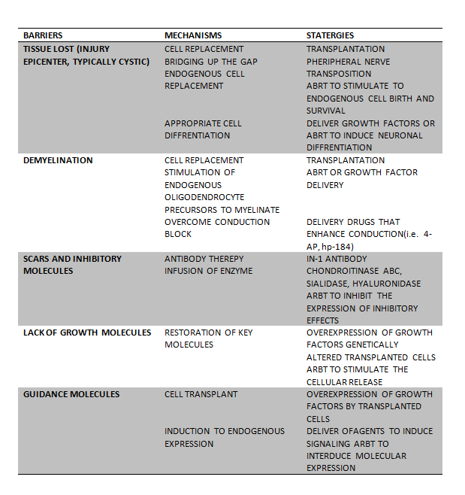

Slide 29
Transplanting embryonic stem cells as therapy for spinal cord injury
Unique features make ES cells primary candidates
Can replicate indefinitely while maintaining genetic stability
Being pluripotent, can differentiate into every cell type
Cells can be genetically manipulated in unprecedented ways
Low immunogenicity

Slide 30
Previous experiments involving murine neuronal progenitors have shown that ES cells
(1) Survive for weeks after transplantation
(2) Do not form teratomas in the spinal cord
(3) Differentiate into the three cell types of the neuronal lineage (neurons, oligodendrocytes, and astrocytes)
(4) Induce functional improvements
McDonald JW, Liu XZ, Qu Y, et al. Transplantedembryonic stem cells survive, differentiate and promoter ecovery in injured rat spinal cord. Nat Med1999;5(12):1410–2
Cummings BJ, Uchida N, Tamaki SJ, et al. Human neural stem cells differentiate and promote locomotor
recovery in spinal cord-injured mice. Proc NatlAcad Sci USA 2005;102(39):14069–74

Slide 31
Possible mechanisms for improvement
ES cells can secrete neurotrophic factors at the injury site
Differentiated derivatives of ES cells can remyelinate surviving axons as well as regenerating axons
Improve function by integrating themselves into a host’s motor and sensory circuits.

Slide 32
Activity-based restoration therapy
The spinal cord below the level of injury experiences the consequences of reduced neural activity after SCI
Optimal neural activity is required to maximize spontaneous recovery of function after nervous system injury.
Rehabilitative therapy needs to precede any molecular or cellular therapeutic intervention to recover function after SCI to optimize curative efforts.
Cummings BJ, Uchida N, Tamaki SJ, et al. Human neural stem cells differentiate and promote locomotorrecovery in spinal cord-injured mice. Proc NatlAcad Sci USA 2005;102(39):14069–74.

Slide 33
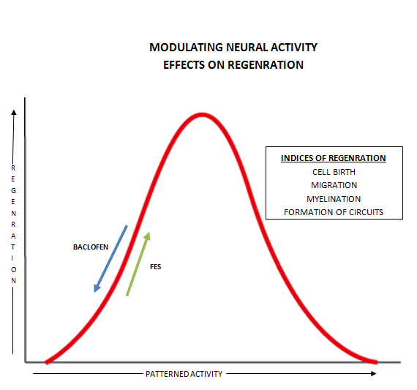

Slide 34
Peripheral nerve injury
Capacity for regeneration in peripheral nerve is higher than that of the central nervous system
Even then, complete recovery is fairly infrequent, misdirected, or associated with debilitating neuropathic pain.
Combined approaches with cells or trophic factors within synthetic tubes may extend their functionality

Slide 35
Possible sources for peripheral nerve repair
Embryonic neural stem cells
Bone marrow cells
Adipose tissue
The skin and its associated structures

Slide 36
Considerations for Optimizing Stem Cell
Therapy for Peripheral Nerve Repair
Optimization strategies should take the number of delivered cells into account
(Mosahebi A, Woodward B, Wiberg M, et al: Retroviral labeling of Schwann cells: in vitro characterization and in vivo transplantation to improve peripheral nerve regeneration. Glia34:8–17, 2001)
Direct microinjection , suspension within artificial tubes and seeding within devitalized muscle or nerve grafts

Slide 37
It is expected that cells will be prompted by the microenvironment to differentiate into the required cell type as shown by invitro studies
(Brannvall K, Corell M, Forsberg-Nilsson K, et al: Environmental cues from CNS, PNS, and ENS cells regulate CNS progenitor differentiation. Neuroreport 19:1283–1289, 2008)
Choosing to predifferentiate stem cells toward a desired phenotype prior to delivery into the repair site

Slide 38
Survival and effectiveness of transplanted cells can be improved by ex vivo genetic manipulation or concomitant delivery of protective agents or trophic factors
Pan HC, Chen CJ, Cheng FC, et al: Combination of G-CSF administration and human amniotic fluid mesenchymal stem cell transplantation promotes peripheral nerve regeneration.Neurochem Res , 2008
Differences in the material in which stem cells are delivered have demonstrated varying capacities to support long-term cell survival
Cao F, Sadrzadeh Rafie AH, Abilez OJ, et al: In vivo imaging and evaluation of different biomatrices for improvement of stem cell survival. J Tissue Eng Regen Med 1:465–468,2007
Immunosuppressive regimens
Parr AM, Kulbatski I, Wang XH, et al: Fate of transplanted adult neural stem/progenitor cells and bone marrow-derived mesenchymal stromal cells in the injured adult rat spinal cord and impact on functional recovery. Surg Neurol 70:600–607, 2008

Slide 39
Effect of bone marrow-derived mononuclear cells on nerve regeneration in the transection model of the rat sciatic nerve
Journal of Clinical Neuroscience, Volume 16, Issue 9, September 2009, Pages 1211-1217
Rohit Kumar Goel, Vaishali Suri, Ashish Suri, Chitra Sarkar, Sujata Mohanty, Meher Chand Sharma, Pradeep Kumar Yadav, Arti Srivastava
Study demonstrated that local delivery of BM-MNCs (which can be isolated easily from bone marrow aspirates) into injured peripheral nerve increases the rate and degree of nerve regeneration

Slide 40
Nilesh K ,Suri A etal.
Semi quantitative and quantitative assessment of the effect of bone marrow derived mononuclear cells (BM-MNC) on early and late phase of nerve regeneration in rat sciatic nerve model.
Observed statistically significant difference in the number of fibers, percentage of axons, percentage of myelinated fibers and axon diameter, fiber diameter myelin thickness in the two groups. These differences were evident at the repair site and at intermediate distal site at 15 days and at the distal most site at the end of 60 days

Slide 41
Stroke
Stroke is the leading cause of death and disability in the United States
Treatment of stroke has emphasized prevention and protection, but little has been done in the brain to repair stroke.
An approach to functional repair would be replacing the damaged tissue with new cells

Slide 42
The neuronal cells could improve neurological function through a number of different mechanisms.
Provision of neurotrophic support (acting as local pumps to support cell function)
Provision of neurotransmitters
Reestablishment of local interneuronal connections cell differentiation and integration
Improvement of regional oxygen tension

Slide 43
Ongoing study by Dr. K prasad etal. Dept of neurology ,AIIMS
Injected stem cells taken from the patient's bone marrow back into his antecubital vein
50% in the stem cell group became free of deficits like weakness of one limb and inability to walk as against 30% in the control arm
Large-scale DBT-funded multi-centric study is on.

Slide 44
Parkinson’s Disease
Medical treatment and even surgical approaches are not permanent solutions, given the increasing side effects that arise over time.
Stem cell therapy holds tremendous promise for being one of the most exciting therapeutic avenues of the future

Slide 45
Cell culture systems in which stem cells are differentiated into dopaminergic cells that are then transplanted into the SN or its target areas.
This may offer a stable long term solution in terms of motor symptom suppression
Initially realized by proof-of-principle studies
with fetal brain transplants.

Slide 46
Fetal VM tissue transplantation
Freed et al.
Forty patients
Robust graft survival was demonstrated by PET and confirmed on postmortem.
Study failed to meet its primary endpoint of clinical improvement
Troubling off-period dyskinesias were observed
in 15% of the patients receiving neural transplantation.
Freed CR, Greene PE, Breeze RE, et al. Transplantation of embryonic dopamine neurons for severe Parkinson’s disease. N Engl J Med 2001;344:710–9.

Slide 47
Olanow et al.
34 patients
Striatal fluorodopa uptake was significantly increased
There was no significant improvement in the motor component
Off-medication dyskinesias were observed in as many as 56% of the patients who received transplants.
Olanow CW, Goetz CG, Kordower JH, et al. A double- blind controlled trial of bilateral fetal nigral transplantation in Parkinson’s disease. Ann Neurol 2003;54:403–14.

Slide 48
Generating dopaminergic neurons from stem cells
Requirements
Reliably survive in a high percentage
2. Secrete a standardized amount of dopamine
for consistent efficacy
3. Avoid rejection or induction of an inflammatory response
4. Appropriately connect with the target cells in
the striatum

Slide 49
Most experience so far has supported the notion that only ES cells and fetal brain neural stem cells (NSCs) are reliable sources for dopaminergic neurons
Embryonic stem cells showing the more promising results than NSC

Slide 50
The choice of location for stem cell transplantation?
In every animal experiment, it has become the standard to transplant cells into the striatum
It is important in the long run to transplant dopaminergic cells into the SN.

Slide 51
Stem cells as delivery tools
May serve as vehicles to deliver a wide variety of proteins to specific areas in the brain in an attempt to repair defective neurons rather than replacing them
These include trophic factors, enzymes of the dopamine synthesis pathway, or proteins that are defective in the genetic causes of PD

Slide 52
Future Directions, Toward Clinical Applications
Clinical trials have provided proof of Principle that transplantation of fetal DA neurons can Improve patients’ neurological symptoms
2 “double-blind” clinical trials have shown benefits in subgroups of patients.

Slide 53
Long-term Evaluation of Bilateral Fetal Nigral Transplantation in Parkinson Disease Robert A. Hauser, MD etal. Arch Neurol. 1999;56:179-187.
Six patients with advanced PD underwent bilateral fetal nigral transplantation
Conclusions: Consistent long-term clinical benefit and increased fluorodopa uptake on positron emission tomography. Clinical improvement appears to be related to the survival and function of transplanted fetal tissue

Slide 54
Concerns
Cell survival
Loss of dopaminergic phenotype
Long term recovery prospects
Side effects like dyskinesias
Immunogenicity
Quality of the stem cells cross-species contamination,
Ethical issues

Slide 55
Cell therapy in Huntington disease
3 approaches to HD cell therapy includes
1) The potential for self-repair through the manipulation of endogenous stem cells and/or neurogenesis.
2) The use of fetal or stem cell transplantation as a cell replacement strategy.
3) The administration of neurotrophic factors to protect susceptible neuronal populations.

Slide 56
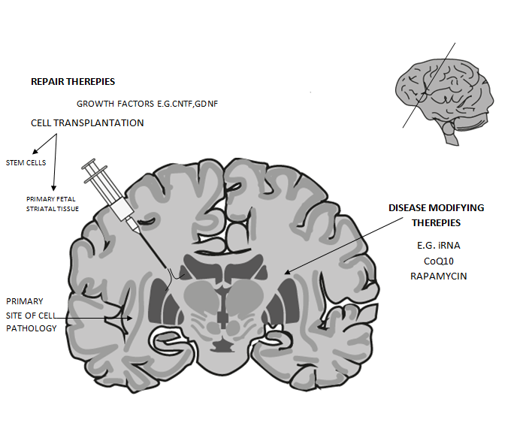

Slide 57
Transplantation of fetal-derived cells into degenerative striatal regions has proven safe and at least partially effective in patients with HD.
The use of both stem cell– and growth factor–based therapies, although in its early stages, appears likely to contribute to future clinical strategies

Slide 58
Other uses
Amyotrophic lateral sclerosis
Lysosomal storage disorders
Retinal Degenerative Diseases
vitreoretinal degeneration
age-related macular degeneration,
retinitis pigmentosa,
numerous forms of retinopathy
Regeneration of the intervertebral disc

Slide 59
Methods of stem cell implantation
Stem Cell Implantation using Brain Stereotactic Surgery
Direct injection to the injury site
Subarachnoid Stem Cell Implantation via Lumbar Puncture
Intravenous transplantation
Hiroki Takeuch etal. Neuroscience Letters ,Volume 426, Issue 2, 16 October 2007, Pages 69-74
Intra-nasal cell delivery
Danielyan,L.,etal.,Intranasaldeliveryofcellstothebrain.Eur.J.CellBiol.(2009),

Slide 60
Problems with use of neural stem cells
Logistic and Ethical problems
The use of allogeneic cells would necessitate immunosuppressive therapy
The potential tumorigenicity of transplanted NSCs
Ideal cellular therapy should comprise autologous cells that can be harvested without difficulty, processed efficiently in vitro, and reinoculated into the same patient.

Slide 61
Alternate sources of stem cells
BM an alternative and much more clinically accessible pool of stem cells
Eliminate the ethical concerns and logistic issues related to the use of allogeneic fetal-derived NSCs
Relative ease of accessibility
BM-derived stem cells represent a potentially important step

Slide 62
Adipose tissue
Comparable phenotypic profile to the bone marrow stromal cells
Kingham PJ, Kalbermatten DF, Mahay D, et al: Adiposederived stem cells differentiate into a Schwann cell phenotype and promote neurite outgrowth in vitro. Exp Neurol 207:267–274, 2007
Skin
neural crest stem cells has been found in the bulge area of hair and whisker follicles
Sieber-Blum M, Grim M, Hu YF, et al: Pluripotent neural crest stem cells in the adult hair follicle. Dev Dyn 231:258–269,2004

Slide 63
Stem cells: Ethics, law, and policy
Ethics and policy debates centered on the moral status of the embryo—whether the 2- to 4-day-old blastocyst is a person
Each country has different moral and regulatory frameworks—one permissive, one restrictive.
Stem cell research involves balancing the interests of 2 groups
1) the cell, gamete, and embryo donors and
2) The volunteers participating in clinical trials

Slide 64
First-in-human trials are high-reward, high-risk endeavors and are full of uncertainty.
Investigators and sponsors should present review committees with a clear and thoughtful research plan that will satisfy requirements to “do no harm.”
Ethicists and nonspecialists should take time to familiarize themselves with the basics of stem cell biology and the predictive power of animal models
The world is watching these experiments to see if the field can live up to its bold promise.

Slide 65
Indian Scenario
ICMR and department of biotechnology has come up with “Guidelines for stem cell research and therapy "in 2007.
These guidelines address both ethical and scientific concerns to encourage responsible practices in the area of stem cell research and therapy
National Apex Committee for Stem Cell Research and Therapy (NAC-SCRT) and Institutional Committee for Stem Cell Research and Therapy (IC-SCRT) formed to review and monitor stem cell research .

Slide 66
Use of stem cells for therapeutic purposes
As of date, there is no approved indication for stem cell therapy as a part of routine medical practice, other than Bone Marrow Transplantation (BMT)
All other usages are experimental and should be done with prior permission from the regulatory body.

Slide 67
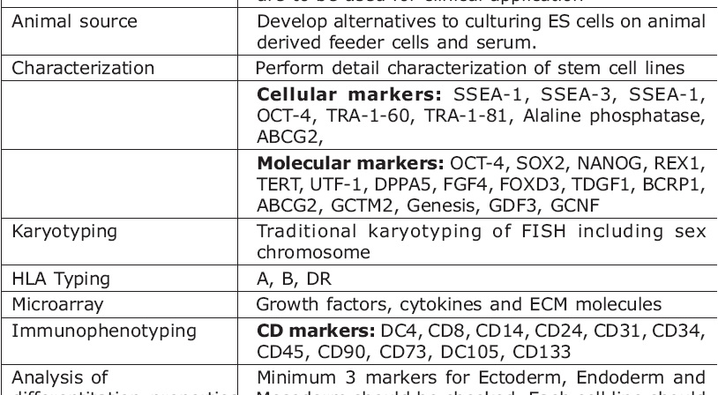
Safeguards for Use of Human Embryonic Stem (HES) Cells

Slide 68


